Slide 1
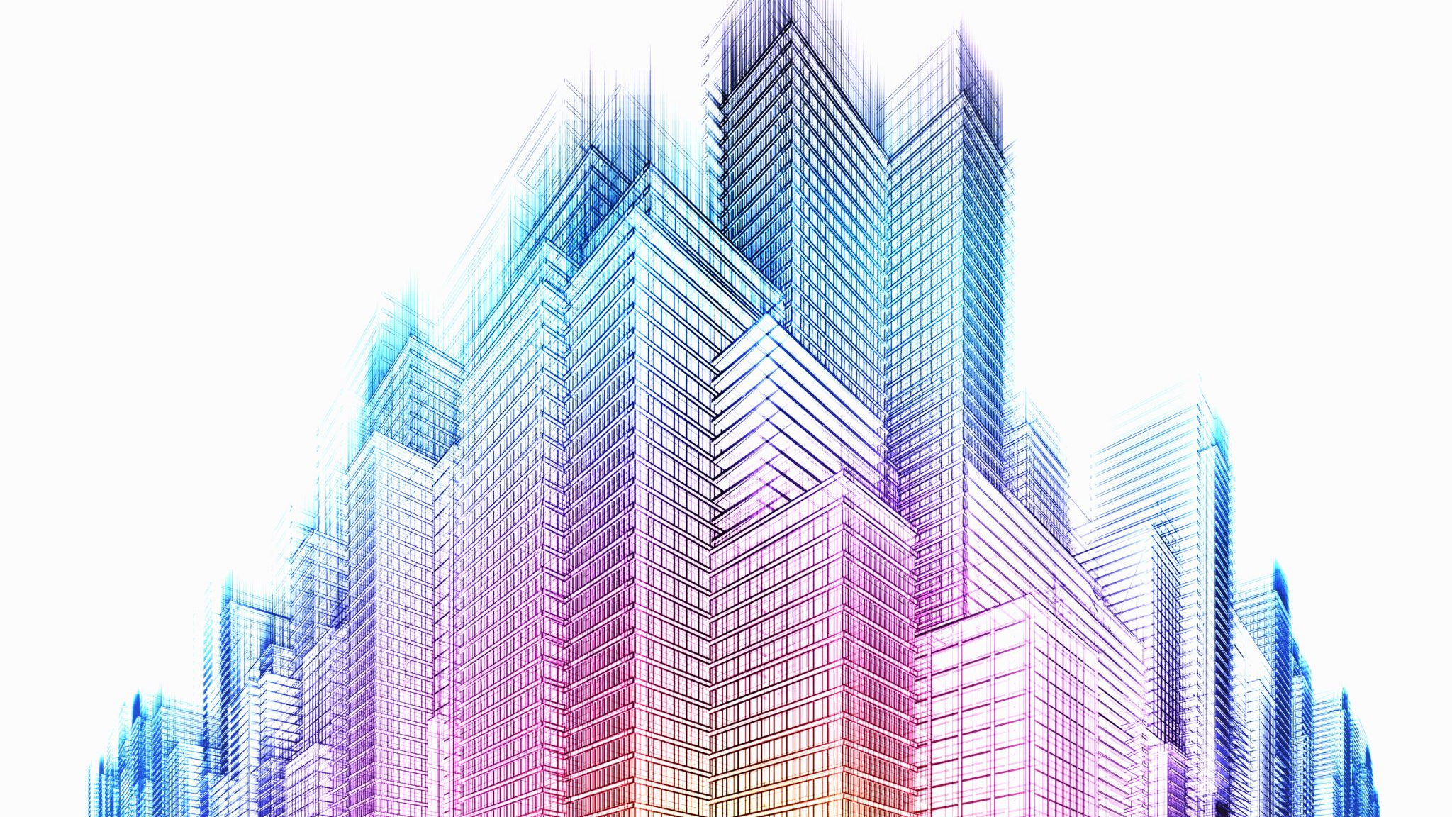
Applied DATA SCIENCE CAPSTONE MUMBAI CITY INFRASTRUCTURE
By: HITESH CHHUGANI

Slide 2
Contents
Introduction
Problem Statement
Data Acquisition
Feature Extraction
Results
Discussion
Conclusion

Slide 3
Introduction
The purpose of this Project is to help people in exploring better facilities around their neighbourhood. It will help people making smart and efficient decision on selecting great neighbourhood out of numbers of other neighbourhoods in Mumbai, Maharashtra, India.
Mumbai is a financial capital of India so Lots of people are migrating from various states of India to Mumbai for their livelihood Therefore they need lots of research for area with good infrastructure.
It will help people to get awareness of the area and neighbourhood before moving to a new city, state, country or place for their work or to start a new fresh life.

Slide 4
Problem Statement
The questions I aim to answer in this project are the following:
1. List and visualize all major parts of Mumbai City with top existing infrastructure.
2. What are the best locations in Mumbai as per infrastructure?
3. Which all areas lack the infrastructure facilities?

Slide 5
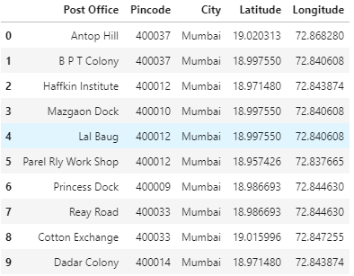
Data Acquisition
Data of the neighbourhoods in Mumbai was scraped from https://www.nativeplanet.com/india-pin-codes/maharashtra/mumbai/
Geographical co-ordinates using geocoder library
Foursquare API was analysing venues in neighbourhood.

Slide 6
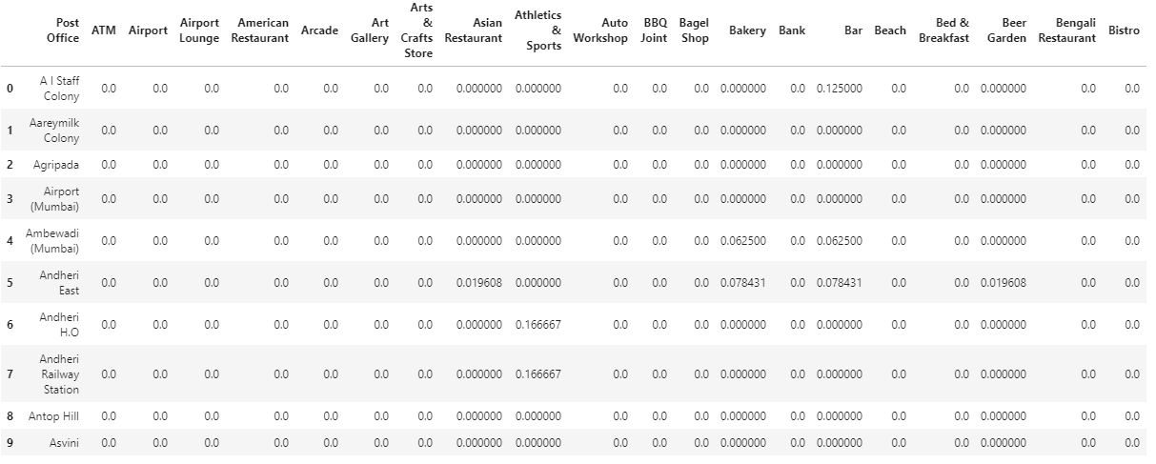
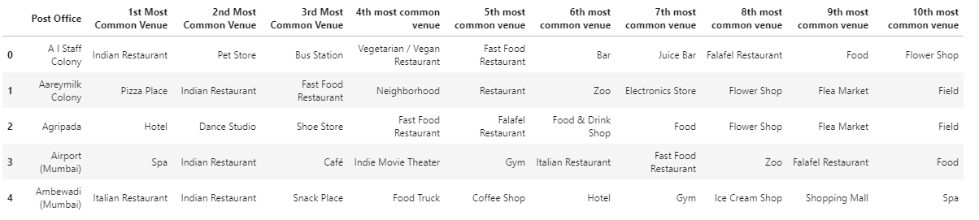
Feature Extraction

Slide 7
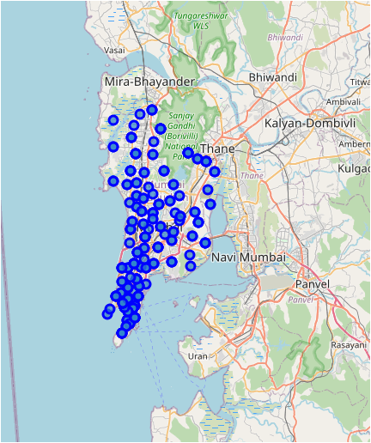
Results
Folium, a map was plotted to show how the different neighbourhoods are spread all across Mumbai

Slide 8
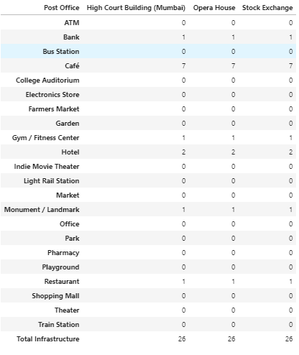
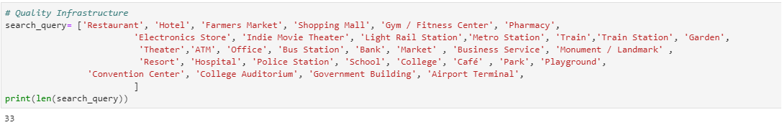
Results
Best Location in Mumbai: 3 places are with best infrastructure
Quality infrastructure to choose the best possible area in Mumbai

Slide 9
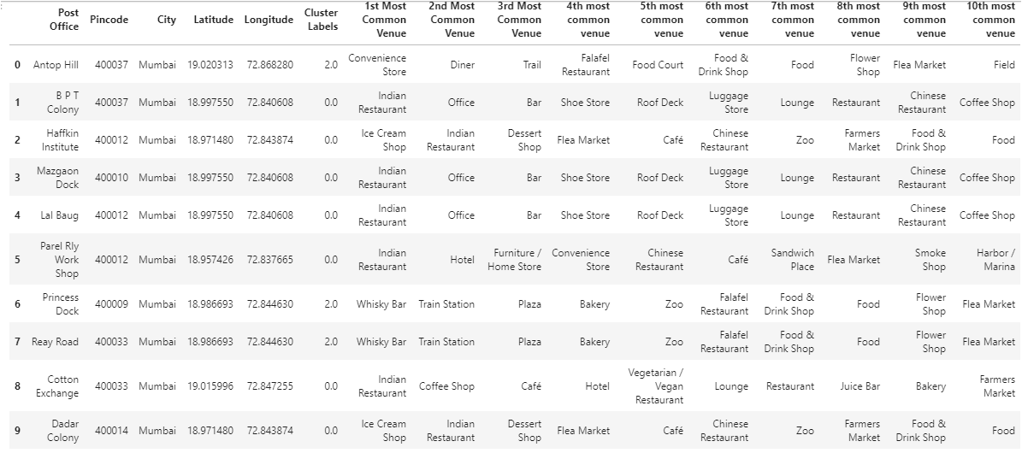
Result
Least Infrastructure Area in Mumbai: 35 places were find to be least infrastructure

Slide 10
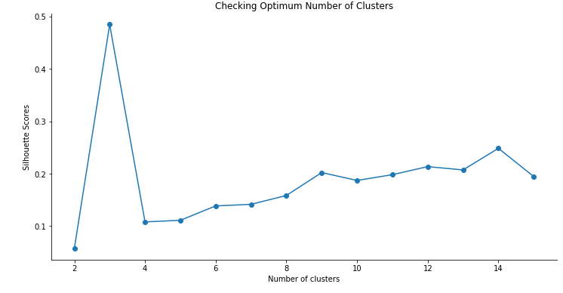
Results: Best K for Kmeans
Silhouette scores are plotted for different number of cluster from 2 to 15.
3 cluster were used for cluster analysis.

Slide 11
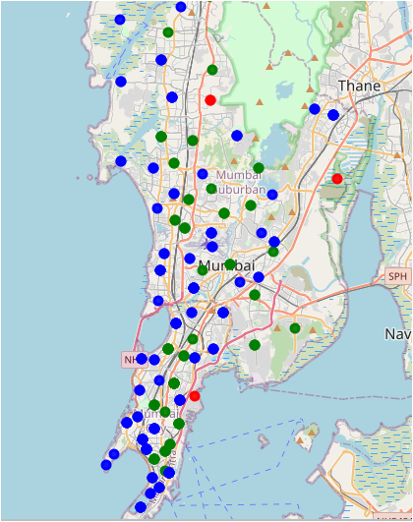
Results: Clustering
Cluster 0 (Red):
Cluster 1 (Blue):
Cluster 2 (Green):

Slide 12
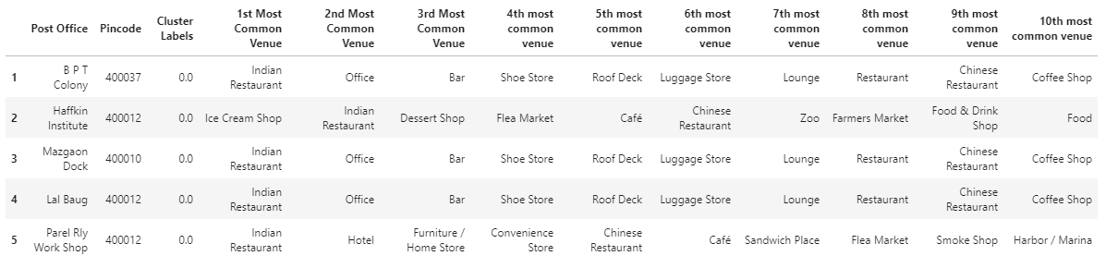
Results: Clustering
0: Cluster: Cover 78 Post Office of Mumbai

Slide 13
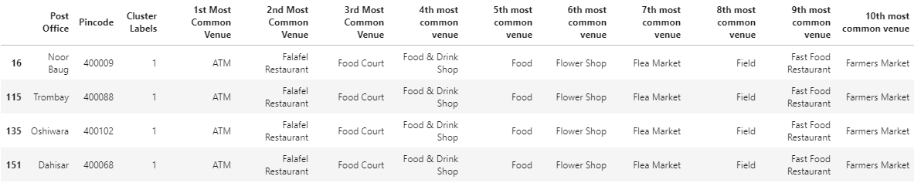
Results: Clustering
1: Cluster: Just 4 Post office of Mumbai

Slide 14
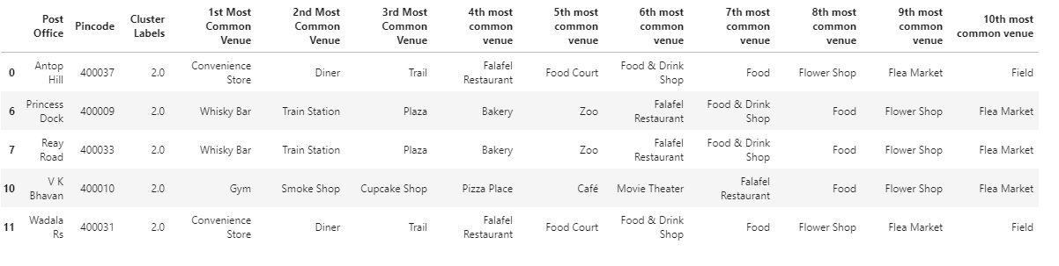
Results: Clustering
2: Cluster: 131 Post Office of Mumbai

Slide 15
Discussion
Mumbai has a very good rail connectivity with different parts of the city therefore transportation is not a problem, therefore area near to your job location can be chosen. What Mumbai has a problem of highly expensive houses, so best area can be selected with affordable house price near to the job location along with the facilities like schools, malls, bank, hospital and other basic need requirements.
The basic infrastructure were selected from different venue's. This infrastructure are located in different areas in Mumbai. Finally, the area with the best infrastructure is selected. Along with this the area with least infrastructure were located. High Court Building, Opera House and Stock exchange were some areas of best infrastructure in Mumbai.
There are 35 areas with least infrastructure from that list.

Slide 16
Discussion
Clusters were selected with the help of silhoette score. from 2 to 15 no.s of clusters silhouette score is plotted. 3 Cluster are used as it gives maximum value of silhouette score.
Cluster 0 looks like area with multiple office along with other basic needs facility as well as restaurants and other facilities for enjoyment as along with professional life there need some good social life. So this cluster look good for the people coming to this city and having work location within this cluster.
Cluster 1 is a very small cluster of 4 different areas which include food courts and some farmers market. So this cluster doesn't look great to stay in Mumbai from the basic infrastructure point of view.
Cluster 2 is a very big cluster include restaurants , spa, gym, bar , lounge and Hotel. This cluster looks good for new people coming to this city. This cluster also includes hotels, lounge therefore also can be the good area for the tourist in the city, as this area includes airport along with other enjoyment places.

Slide 17
Conclusion
I have successfully analysed the neighbourhoods in Mumbai, India for determining the location for the new people coming to the city. The people coming to the cities can look from the area with good infrastructure like hospitals, schools, gym, malls and proper connectivity with different parts of the city. High Court Building, Opera House and Stock exchange were some areas of best infrastructure in Mumbai.
People can further select the best place according to their job location in the city and there capability of taking the expenses of that area in the city.

Slide 18
Final Comments
In order to view the code for this project, kindly refer to the notebook on the github repository at: https://github.com/HITESH2596/Coursera_Capstone/blob/main/MUMBAI_APPLIED_CAPSTONE.ipynb

